Slide 1
FHIR Starter: Architecture
Lloyd McKenzie
June 25, 2018

Slide 2

Who am I?
Name: Lloyd McKenzie
Company: Gevity
Background:
One of FHIR’s 3 initial editors
Co-chair FMG, FHIR-I and MnM
HL7 Fellow
Heavily involved in HL7 and healthcare exchange for last 19 years
v2, v3, CDA, etc.
lmckenzie@gevityinc.com

Slide 3
This presentation
Can be downloaded here:
https://github.com/FHIR/documents/blob/master/presentations/2018-06%20Russia/FHIR%20Architecture.pptx
Is licensed for use under the Creative Commons, specifically:
Creative Commons Attribution 3.0 Unported License
(Do with it as you wish, so long as you give credit)

Slide 4
Learning Objectives
You should be able to:
List FHIR’s interoperability paradigms and describe some of the pros and cons of each
Identify some of the architectural considerations associated with FHIR
Understand a little bit about FHIR profiling
Notes:
Have < 3 hours so focus is more on “identifying considerations” than deeply exploring options

Slide 5
What Paradigm

Slide 6
Paradigms
FHIR supports 3 main interoperability paradigms
REST
Documents
Messages
Other
What should you use when?
Notes:
Temperature check – how many people feel they’ve got a good handle on the paradigms and when they’d use them vs. not. (This isn’t really FHIR-specific)

Slide 7
REST
Simple, out-of-the-box interoperability
Leverage HTTP: GET, POST, etc.
Pre-defined operations
Create, Read, Update, Delete
Also: Read Version, Search (resource/type/server), History (resource/type/server), Capabilities, Patch, Batch & Transaction
Rest
Notes:
Review

Slide 8
FHIR REST
Pros
Cons
Easy to use
Builds on the HTTP Stack
Fast and light-weight
Minimal negotiation required
No context about what’s happening
Requires client-server architecture
Requires identity at the resource level

Slide 9
Documents
Similar to CDA
Collection of resources bound together
Root is a “Composition” resource
Just like CDA header
Sent as a Bundle resource
One context
Can be signed, authenticated, etc.
Documents

Slide 10
FHIR Documents
Pros
Cons
Familiar paradigm to clinicians
Expectation is all data retained
Tight control over display
More overhead to share data
No ability to initiate workflow
More negotiation required

Slide 11
Messages
Similar to v2 and v3 messaging
Also a collection of resources as a Bundle resource
Allows request/response behavior with bundles for both request and response
Event-driven
E.g. Send lab order, get back result
Can be asynchronous and/or indirect
Messages

Slide 12
FHIR Messaging
Pros
Cons
Most familiar paradigm for legacy implementers
Supports complex workflows
Can be asynchronous or routed
More overhead
Lots of negotiation required

Slide 13
Other
FHIR can be used for interoperability in other ways too
REST-like remote procedure calls
Payload in SOAP messages
Persistence model for shared database interface
…
Only requirement is that data complies with one of the FHIR syntaxes and the FHIR semantics
Other
Notes:
With REST you have to use HTTP - for SOA, you can use SOAP or whatever infrastructure you lik
Could pass individual data types
Only constraint is data you are passing is valid against FHIR schema

Slide 14
Combining paradigms
No requirement for a system to only support one paradigm
E.g. hospital may be primarily messaging, but use documents for discharge summaries and reports and expose registries and appointments via REST with a few custom services for decision support or specialized workflow
Data (generally) shared easily across paradigm boundaries
Notes:
Consider multiple paradigms when creating instances – don’t want to have to re-craft the narrative because you want to use a resource now in a document instead of a message

Slide 15
FHIR Features
And the architecture decisions that go with them
Notes:
10:00

Slide 16
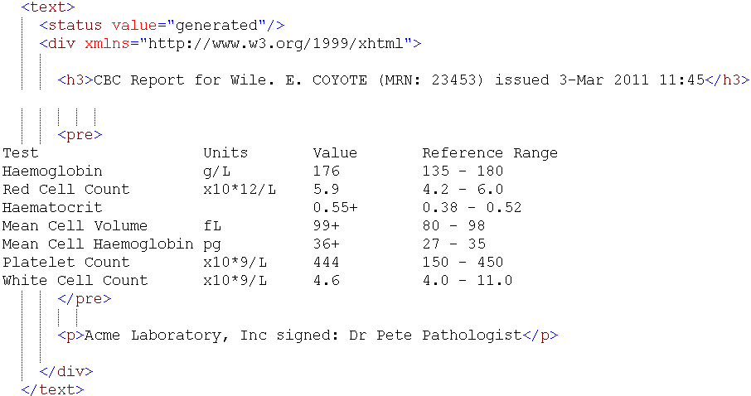
Narrative

Slide 17
Narrative Considerations
Should narrative be generated or human-entered?
What should be included and how should it be formatted?
When should you display narrative?

Slide 18
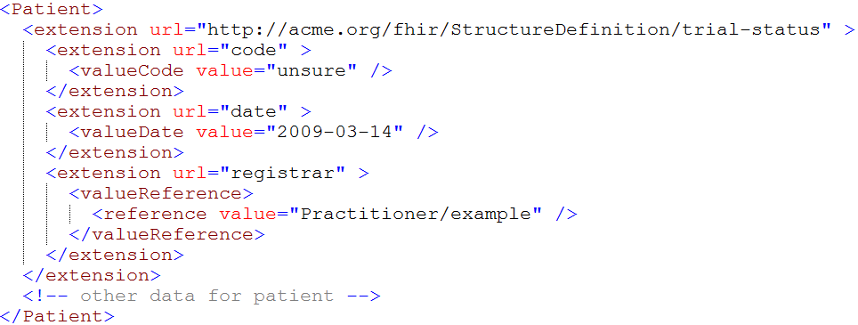
Extensions

Slide 19
Extension Considerations
What do you do if you receive an unrecognized extension?
Should you store unrecognized extensions?
Should you display unrecognized extensions?
What should you expose as an extension?
Where should you register your extensions?

Slide 20
Modifier Extensions
Also a core part of FHIR
Needed because some extensions can’t be safely ignored
Can’t compute on an element containing an unrecognized modifier extension. However, can:
Reject instance
Remove element containing unrecognized modifier extension
Just display narrative
Retrieve definition & seek human review
When should you introduce them?

Slide 21
Versions
33, v12 – 2012-12-04
/server.org/fhir/Patient/33/_history/12
33, v13 – 2012-12-05
/server.org/fhir/Patient/33/_history/13
33, v14 – 2012-12-08
/server.org/fhir/Patient/33/_history/14
33, v15 – 2012-12-09
/server.org/fhir/Patient/33/_history/15
/server.org/fhir/Patient/33
Notes:
* Note that you have two ways (at one moment) to reach version 15

Slide 22
Tags
Patient
MRN 22234
“Ewout Kramer”
30-11-1972
Amsterdam
Tag: system: http://example.org/fhir/Status
code: Test
Profile: http://hl7.org/fhir/StructureDefinition/us-core

Slide 23
Tags
Allow data to be attached to a resource “outside” the resource
Doesn’t break signature when added/changed
3 types:
Security
Profile
General (workflow, etc.)
Require business agreement
Can’t search by tag if authors don’t include them
And populate the same way . . .

Slide 24
Reference libraries
Currently 5:
C#, Java, Pascal (Delphi), Javascript, Swift
More to come?
Handle parsing, serialization, validation, etc.
Also open source servers, basic clients

Slide 25
Resource identity and location
What relationships will you need?
Where will referenced resources live?
How will you reference those resources?
Where’s the resource – bundled, contained, remote?
Notes:
Contained isn’t a packaging method – used when resource isn’t stand alone.
Say you want to record a prescription for Aspirin, you don’t want to create a medication resource for Aspirin when you don’t have dose/strength --- you would have 10k rows just medication. So we allow you to embed medication resource inside order if you don’t have a stand alone, and can’t reasonable make one.
Part of document
Remote – query for resource if not critical for processing message.

Slide 26
Profiled FHIR
Notes:
10:00

Slide 27
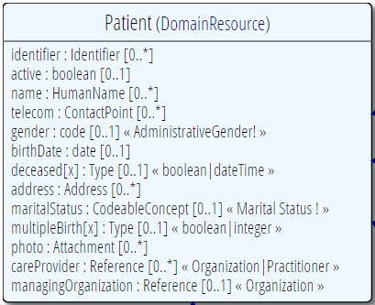
Profiling a resource
Demand that the identifier uses your national patient identifier
Limit names to just 1 (instead of 0..*)
Limit maritalStatus to another set of codes that extends the one from HL7 international
Add an extension to support “RaceCode”
Note: hardly any mandatory elements in the core spec!

Slide 28
Profile-less FHIR
You don’t need profiles to interoperate with FHIR
Resources are “discrete” enough that mechanism to populate most elements is clear
Approach
Populate/consume all elements you know, use HL7 or country-standard extensions for extras
Map to/from “recommended” terminologies as much as possible, populate CodeableConcept.text
Expose capabilities in CapabilityStatement resource
Notes:
With profile, they can interoperate ‘ok’.

Slide 29
Profile Uses
Profiles are still quite useful
Define document and message boundaries
Define extensions
Set interoperability expectations in a particular context
National standards, types of care, business patterns
Clinical practice guidelines / detailed clinical models
Document system capabilities

Slide 30
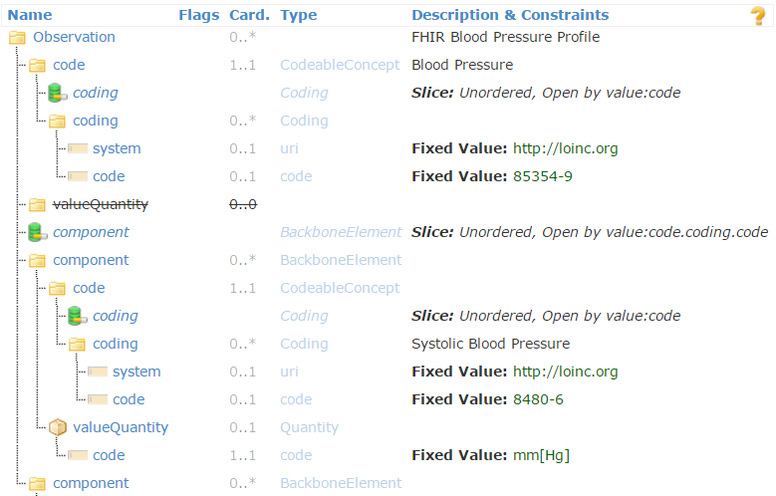
Profiled Observation (Blood Pressure)

Slide 31
Profiles to guide behavior
Profiles can be used to dynamically configure system behavior
Load a profile to guide data entry
E.g. Oncology referral
Load a profile to guide data display

Slide 32
Declaring profiles
Instances can identify what profiles they support using tags
Considerations:
Is declaration version-specific?
Do you trust the declaration to be accurate?
Will all clients declare the profiles of interest on submissions?
What about profiles of interest defined after data is received?

Slide 33
What now?
Notes:
10:00

Slide 34
Dealing with STU
FHIR is a “standard for trial use”
Anything can change – no compatibility promised
Changes driven by implementation feedback
Most changes expected in resources
Already significant implementation experience through reference implementations, connectathons
Some needed resources aren’t yet defined
Outbreak, Public Health Case, etc.
Some content will (hopefully) become normative in FHIR R4 (2018), but most won’t
What goes normative when will depend on degree of implementation

Slide 35

Estimating
How much will implementing a FHIR solution cost?
Considerations
Reference implementations help
Learning curve is lower
Still a curve if unfamiliar with XML / JSON / REST
Faster to “drive by” interoperability
Can’t speed consensus
Tools to help with mapping to internal codes and structures, still takes time
Anecdotal is “faster” to “significantly faster” to implement
Notes:
If I had a guaranteed answer, I’d be too busy to teach this course . . .

Slide 36
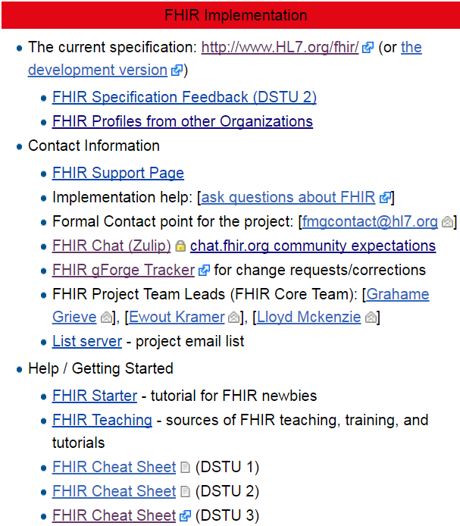
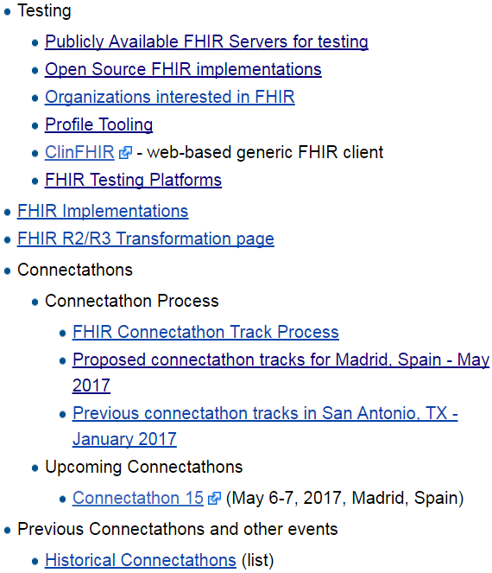
Resources wiki.hl7.org/?title=FHIR

Slide 37

Next Steps for you
Read the spec: http://hl7.org/fhir
Join http://chat.fhir.org
Submit feedback (Propose a Change link)
Form your own local community
Come to FHIR Developer Days
Come to an HL7 WGM

Slide 38

Questions?
http://hl7.org/fhir lmckenzie@gevityinc.com

